Slide 1
Data Sources

Slide 2
Today’s Agenda
Draft Proposals/ Proposal Peer Reviews
Causal Inference: Adjusting for Observables
Clarification on ‘economics’ requirement
Finding Data
Evaluating Data
Working time
Download a dataset for your project
Verify that it has the right info
Check the size
Run an initial analysis
Share with a group of peers
Record all this in Canvas survey

Slide 3
Adjusting for Observables
Subclassification (Cochran 1968)
Nearest Neighbor Matching (Abadie and Imbens 2006, 2008)
Propensity Score (Rosenbaum and Rubin 1973)
Multivariate Regression (Control Variables)

Slide 4
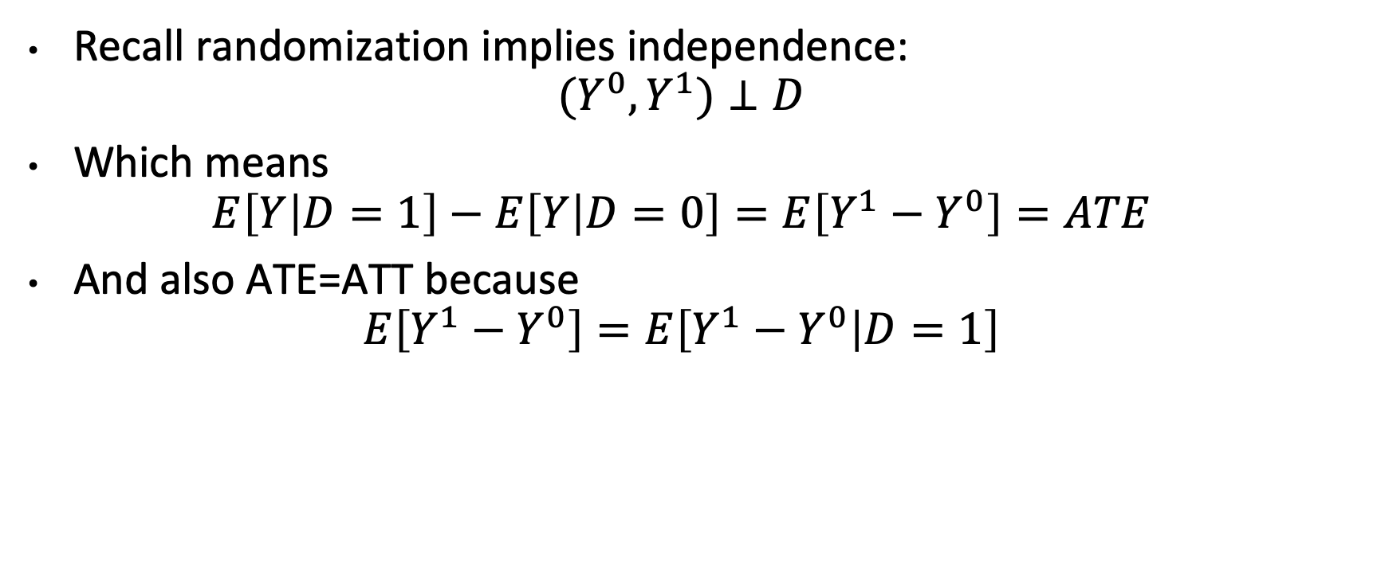
Identification under independence

Slide 5
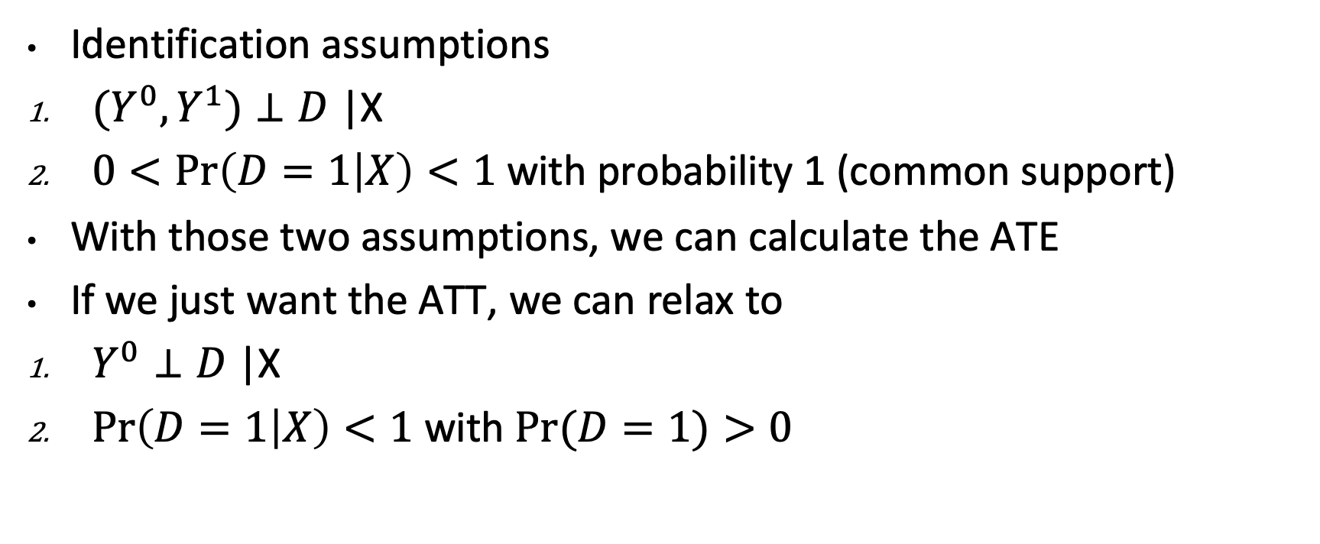
Conditional Independence

Slide 6
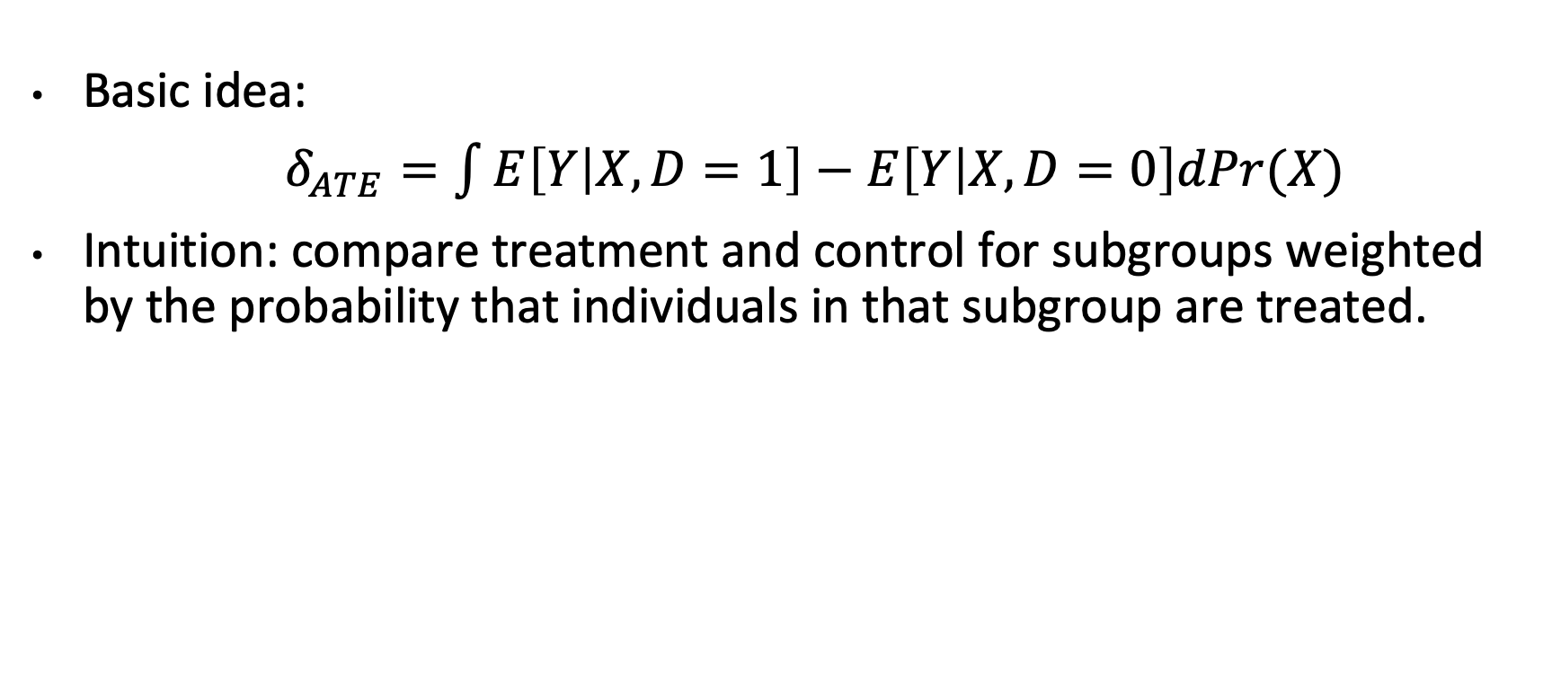
Subclassification Estimator

Slide 7
Example: Israeli COVID Data
Nearly 60% of new patients hospitalized for COVID as of August 15, 2021 are vaccinated.
Does this mean vaccines are ineffective?

Slide 8
Israeli COVID Data
Several problems:
Vaccination rates are high. (Base rate fallacy)
Older people are especially likely to be vaccinated, younger people less so. (Selection)

Slide 9
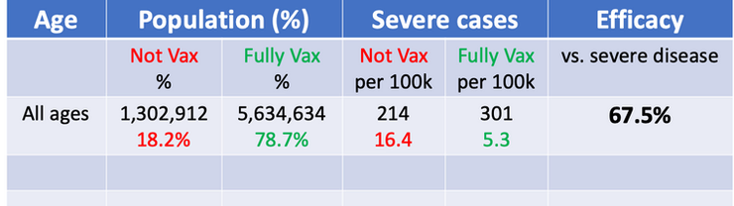
Adjusting for Vaccination Rates
Suppose vaccines were randomly assigned, then we could calculate a difference in means:

Slide 10
Selection Bias
But selection bias still remains! What to do?

Slide 11
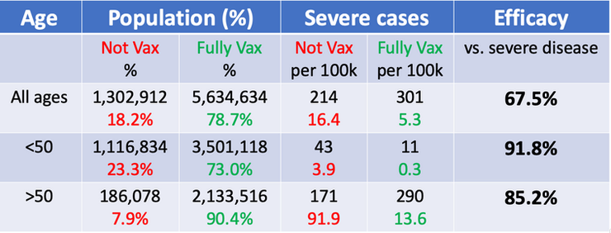
Subclassification
Let’s look at two big age groups:

Slide 12
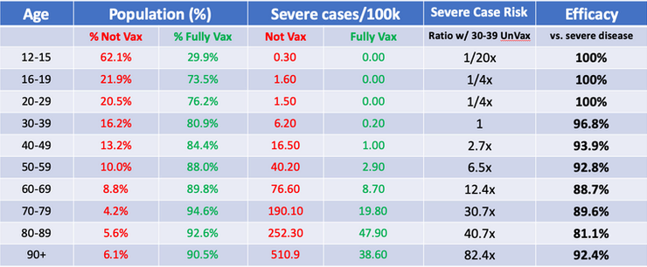
More subclassification
Breaking it down even further

Slide 13
Other methods
Subclassification is often not feasible with lots of covariates.
Options:
Control for X. Works well if we believe that a linear model is accurate.
Nearest neighbor matching: impute the missing potential outcome of each treatment unit by using the observed outcome from that outcomes nearest neighbor j (or an average of several neighbors)
Problem: how to define ‘nearness’? Several options in practice.
Propensity score matching calculates a probability of treatment for each unit, and we compare with units with similar estimates probabilities of treatment. Adjust for propensity score instead of X.
Remember: NONE of these methods address selection on unobservables, which economists frequently worry about.

Slide 14
Important Clarification
If you’re relying on econometrics for the ‘economics’ element of your project, make sure you include causal analysis.
You don’t need an A/B test for causality – other options such as instrumental variables, regression discontinuity, matching, may work.
However, simple OLS regression is unlikely to cut it UNLESS you have randomly assigned treatment.

Slide 15
Finding Good Data
What are we looking for?
A reliable source: government, trusted company, etc.
A large sample size.
Ideally, we want it to be representative of something.
Common pitfalls
The data says it has what we want, but the values are missing.
The documentation is awful or nonexistent.
The dataset is not large enough (especially for ML-type approaches).

Slide 16
Evaluating Data
Download the dataset ASAP!
Descriptions can be misleading.
Unexpected challenges ALWAYS arise.
Are the data you’re interested in:
Appropriately linked to other data? Or linkable?
Non-missing?
Today
Start w/ a list of datasets.
Download one.
Make some scatterplots/ histograms. Seem sensible?
Share a simple interesting graphic or table.

Slide 17
Bureau of Labor Statistics
Consumer price indices (inflation).
Unemployment
Wage data
Productivity
More specific price indices
More!

Slide 18
Living Standards Measurement Surveys
Detailed household data from around the world
Food consumption
Income
Wealth
Crop production
Women empowerment
More!
https://www.worldbank.org/en/programs/lsms

Slide 19
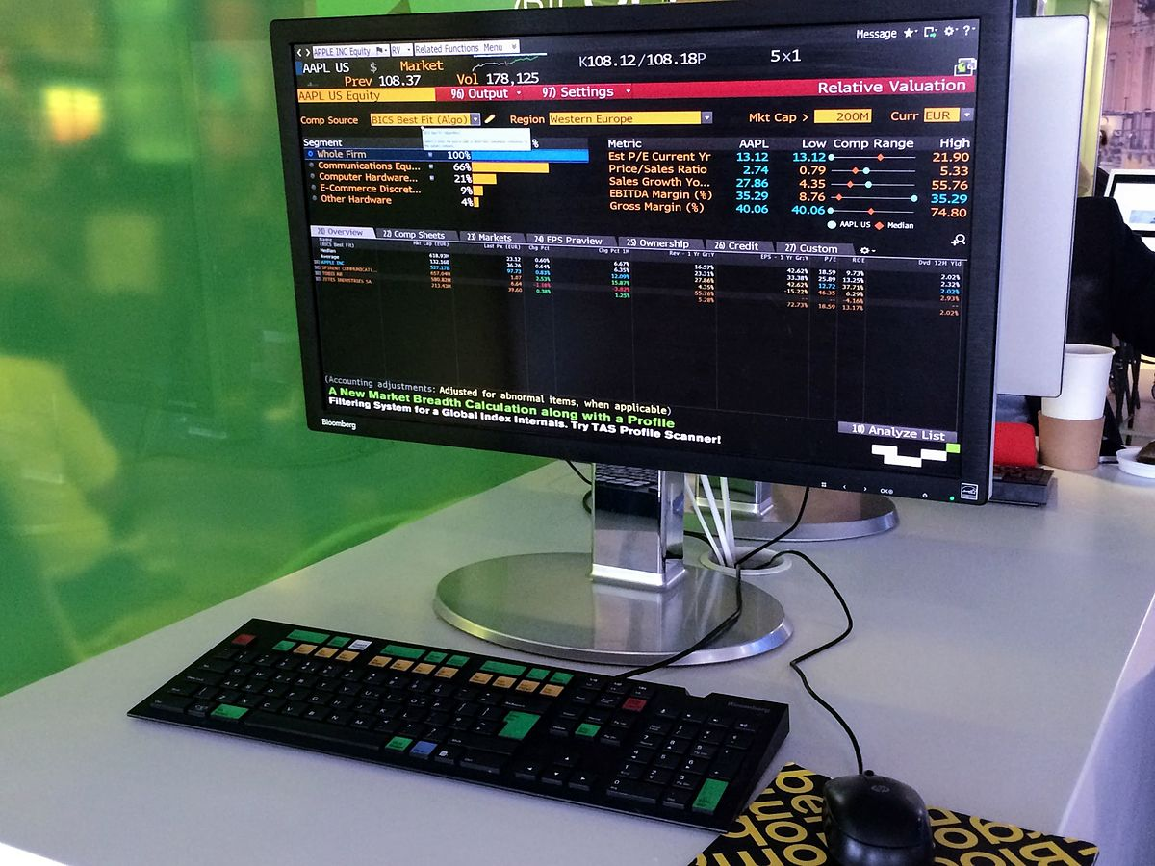
Bloomberg
Bloomberg has very detailed financial data on most anything you could imagine.
USF has a Bloomberg Lab – let me know if you’d be interested in gaining access and I’ll try to find a way.
For today, focus on alternatives, since this won’t be easy to find. Google/ Yahoo Finance could be good places to start.

